Slide 1
Contents
Types of Learning
Statistical Learning
Machine Learning
Supervised Learning:
Decision Trees
Support Vector Machines
Unsupervised Learning:
Clustering.
Dimensionality Reduction

Slide 2
Learning
Learning denotes changes in a system that enable the system to do the same task more efficiently next time. Learning is an important feature of “ Intelligence “.

Slide 3
Learning is the process of acquiring new understanding, knowledge, behaviors, skills, values, attitudes, and preferences

Slide 4
TYPES of Learning
Associative Learning ( Classical Conditioning/Induced – Ivan Pavlov and dogs)
Non Associative Learning ( Habituation )
Active Learning
Episodic Learning
Rote Learning
Meaningful Learning
Evidence Based Learning ( Spaced Repetition of Flashcards )
Play
Enculturation

Slide 5
Statistical Learning
Statistical learning theory is a framework for machine learning drawing from the fields of statistics and functional analysis
Statistical modeling is a formalization of relationships between variables in the data in the form of mathematical equations.
Statistical Learning is mostly about inferences, most of the idea is generated from the sample, population, and hypothesis, in comparison to Machine Learning which emphasizes predictions, supervised learning, unsupervised learning, and reinforcement learning.

Slide 6
MACHINE LEARNING
Machine learning is a subset of artificial intelligence (AI) that provides systems the ability to automatically learn and improve from experience without being explicitly programmed

Slide 7
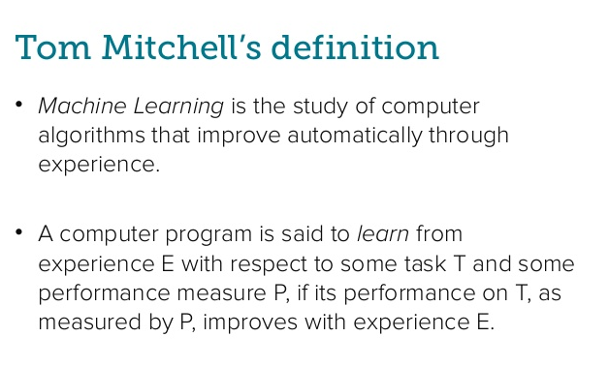

Slide 8


Slide 9
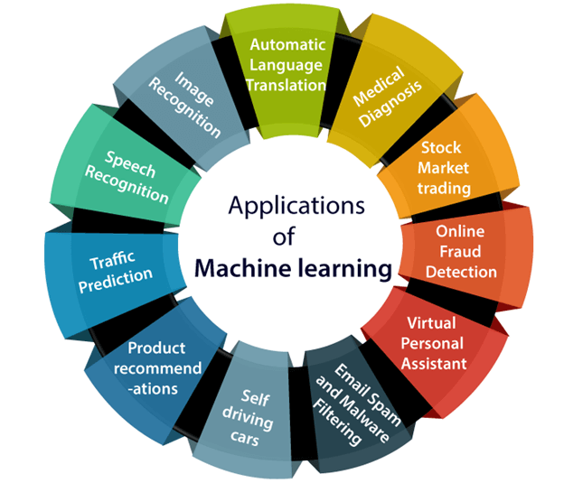

Slide 10
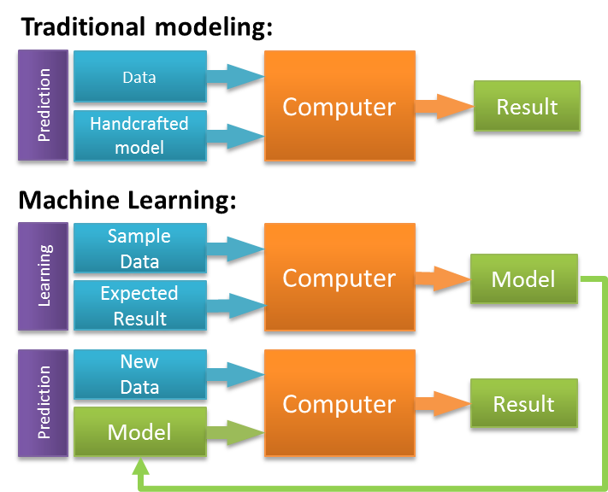

Slide 11
Step 1
Gathering data from various sources
Step 2
Cleaning data
Step 3
Model Building –Selecting the right ML algorithm
Step 4
Gaining insights from the model’s results
Step 5
Data Visualization –Transforming results into visual graphs
STEPS INVOLVED IN MACHINE LEARNING PROCESS

Slide 12
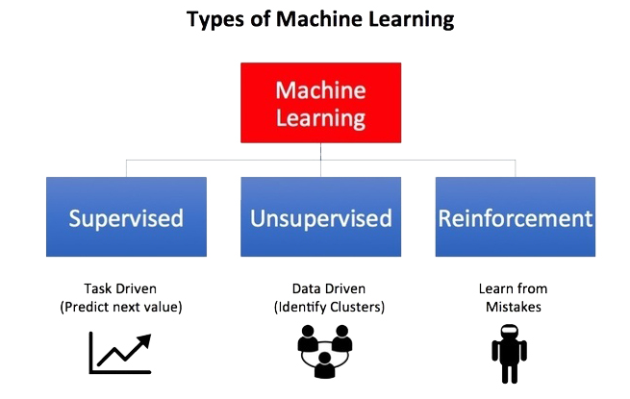

Slide 13
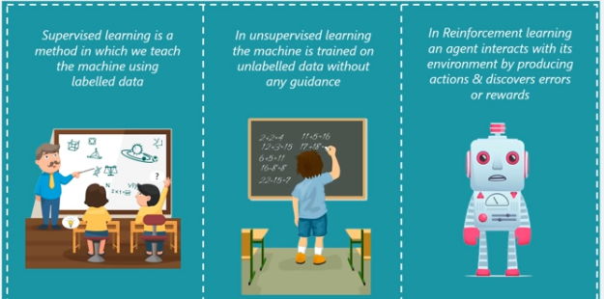
DEFINITION

Slide 14
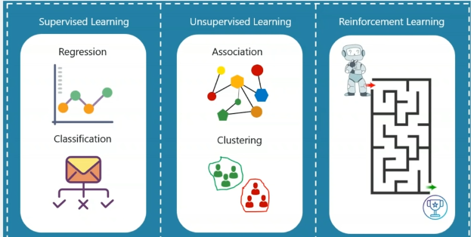
PROBLEM TYPE

Slide 15
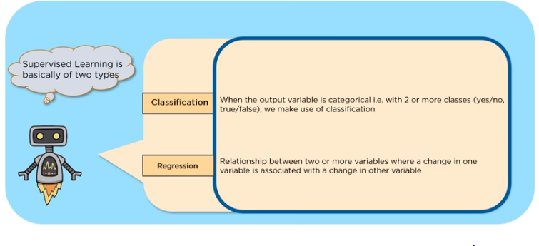
TYPES OF SUPERVISED LEARNING

Slide 16
POLL QUESTIONS
Identify whether the following data is categorical or continuous value
Temperature
Yes or No
True or False
Price
Fit or unfit
Apple or Orange
Humidity

Slide 17
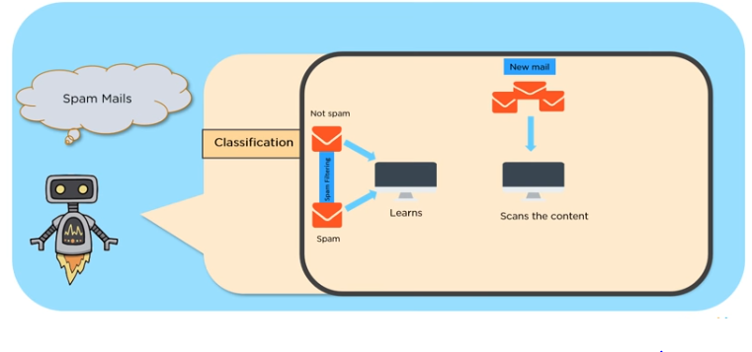
CLASSIFICATION EXAMPLE

Slide 18
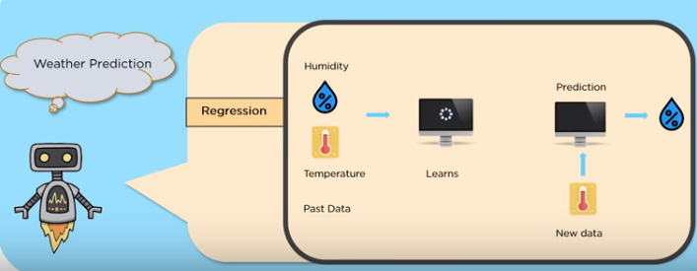
REGRESSION EXAMPLE

Slide 19
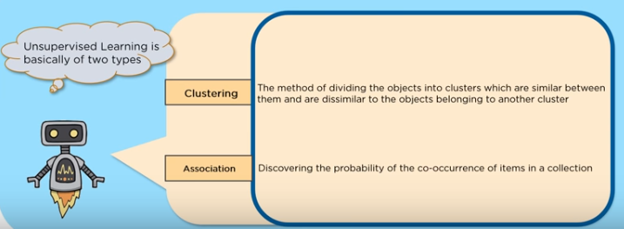
TYPES OF UNSUPERVISED LEARNING

Slide 20
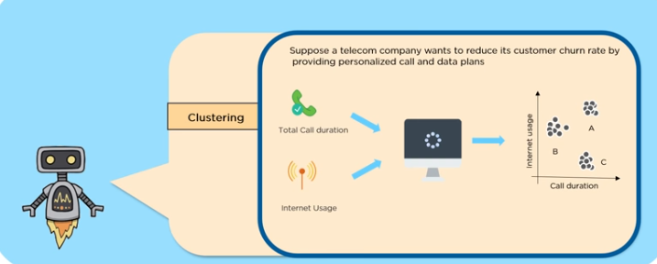
CLUSTERING EXAMPLE

Slide 21
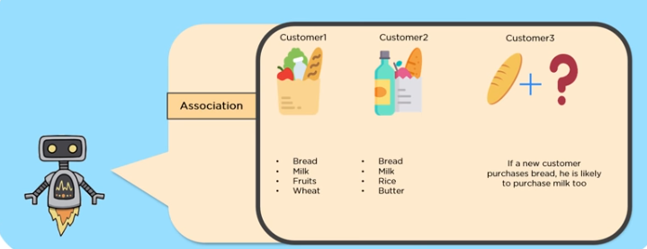
ASSOCIATION EXAMPLE

Slide 22
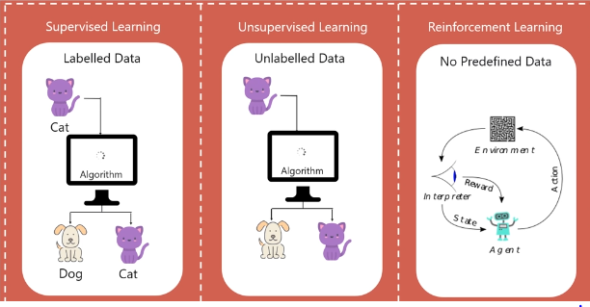
TYPES OF DATA

Slide 23
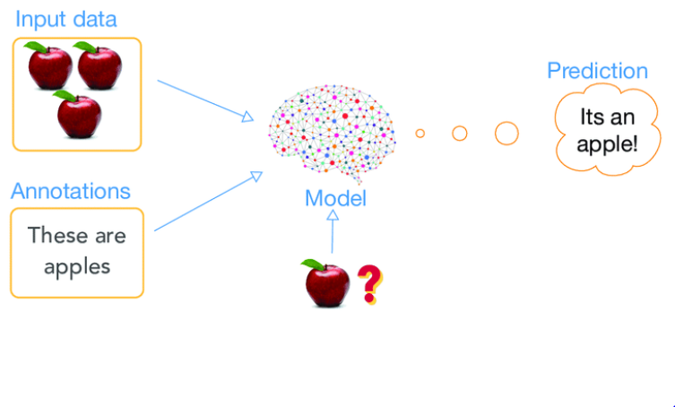
SUPERVISED LEARNING- CLASSIFICATION

Slide 24
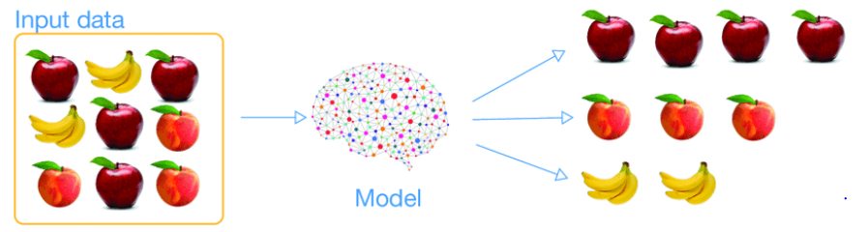
UNSUPERVISED LEARNING – CLUSTERING

Slide 25
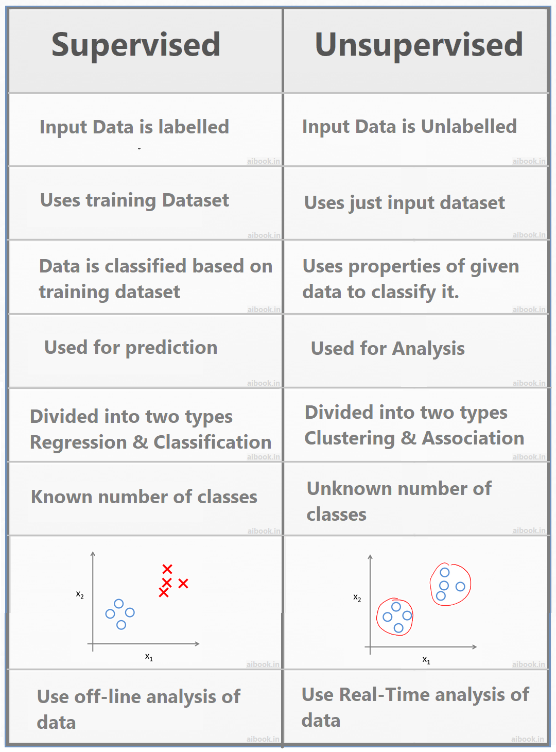

Slide 26

Supervised Learning
Supervised learning is the machine learning task of learning a function that maps an input to an output based on example input-output pairs.
It infers a function from labeled training data consisting of a set of training examples.
In supervised learning, each example is a pair consisting of an input object and a desired output value.
A supervised learning algorithm analyzes the training data and produces an inferred function, which can be used for mapping new examples.
An optimal scenario will allow for the algorithm to correctly determine the class labels for unseen instances.
This requires the learning algorithm to generalize from the training data to unseen situations in a "reasonable" way

Slide 27
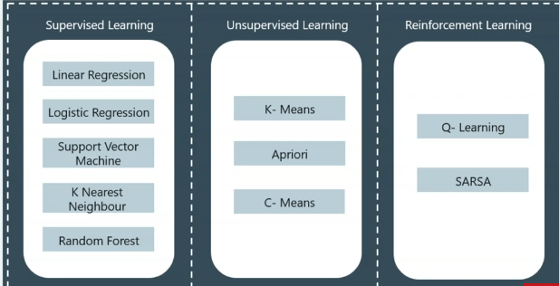
ALGORITHMS

Slide 28
Few Supervised Learning Algorithms
Support Vector Machines
Linear regression
Logistic regression
Naive Bayes
Decision trees
K-Nearest Neighbor

Slide 29
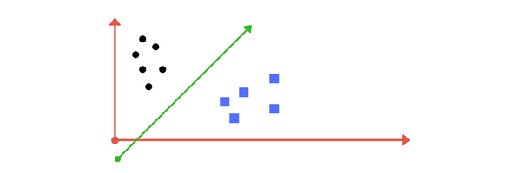
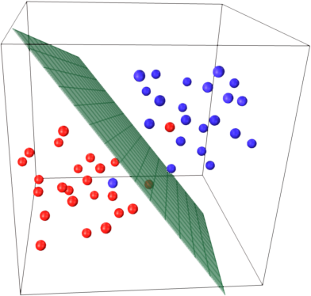
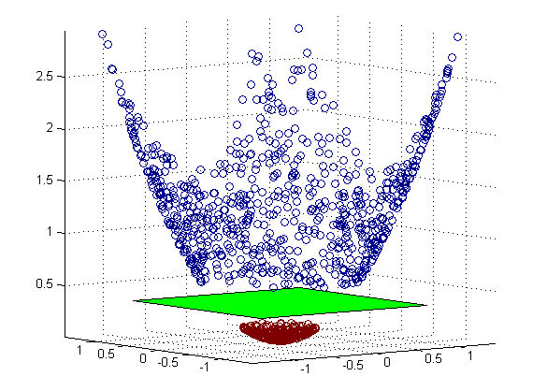
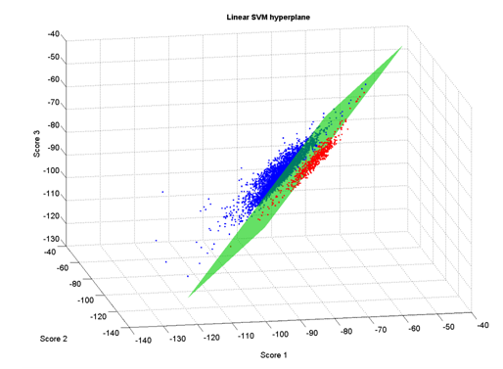
SVM
A Support Vector Machine (SVM) is a discriminative classifier formally defined by a separating hyperplane.
Given labeled training data (supervised learning), the algorithm outputs an optimal hyperplane which categorizes new examples.
In two dimentional space this hyperplane is a line dividing a plane in two parts where in each class lay in either side.

Slide 30
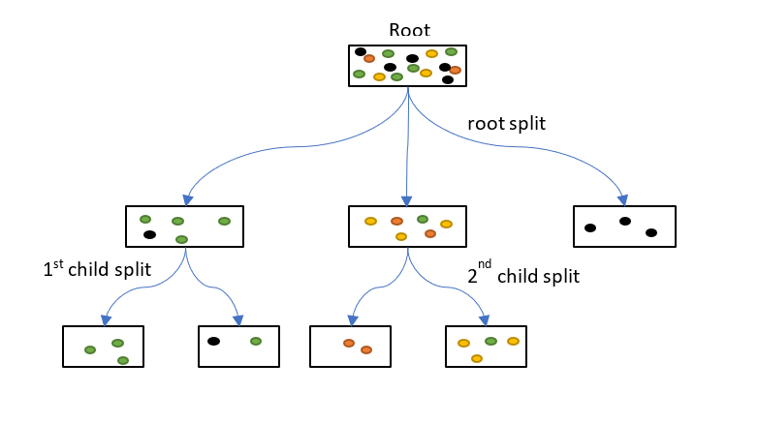
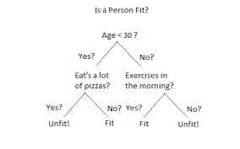
Decision Tree

Slide 31
Decision Tree
A decision tree is a decision support tool that uses a tree-like graph
It is one way to display an algorithm that only contains conditional control statements.
A decision tree is a flowchart-like structure in which each internal node represents a “test” on an attribute (e.g. whether a coin flip comes up heads or tails), each branch represents the outcome of the test, and each leaf node represents a class label (decision taken after computing all attributes).
The paths from root to leaf represent classification rules.
Decision Tree algorithms are referred to as CART (Classification and Regression Trees), ID3,C4.5

Slide 32
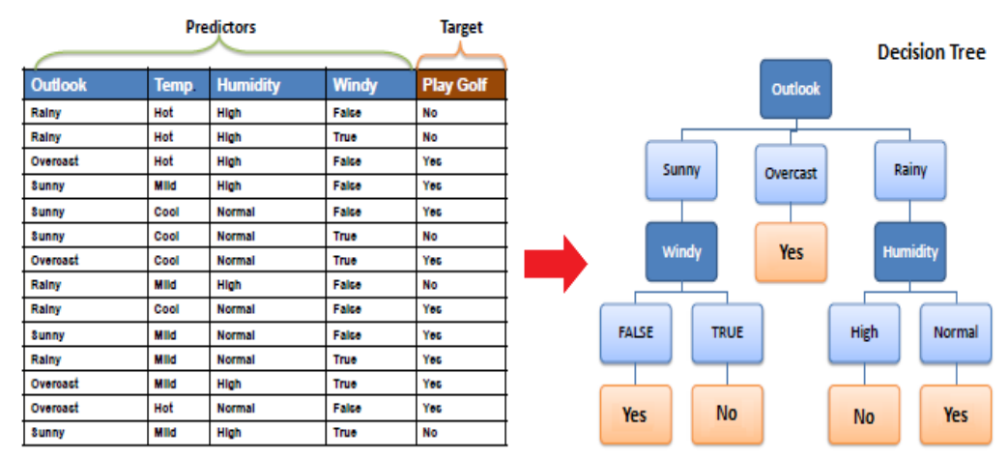

Slide 33
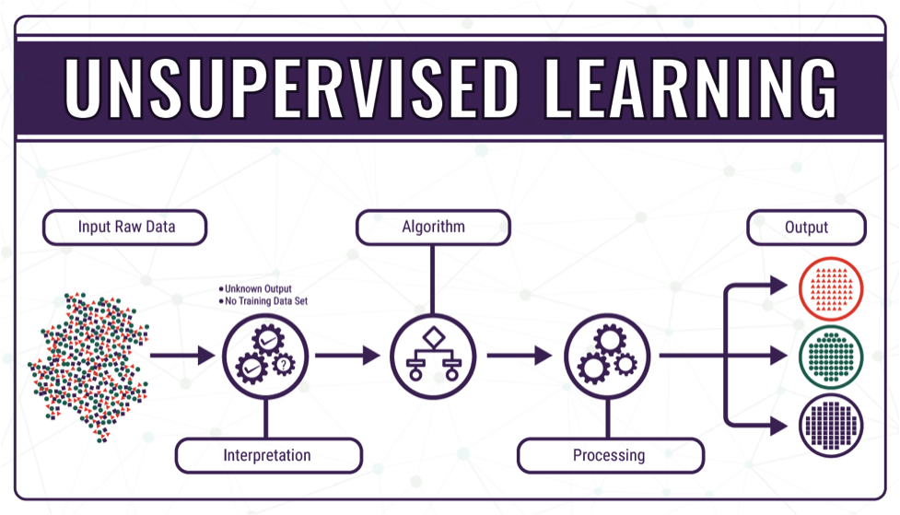

Slide 34
Unsupervised Learning
In unsupervised learning, labels are not available. Therefore, the task of the AI agent is not well-defined, and performance cannot be so clearly measured.
Unsupervised learning problems are less clearly defined than the supervised learning problems and are harder for the AI agent to solve
The unsupervised system is better than the supervised system at finding new patterns in future data
Clustering
K-Means Clustering

Slide 35
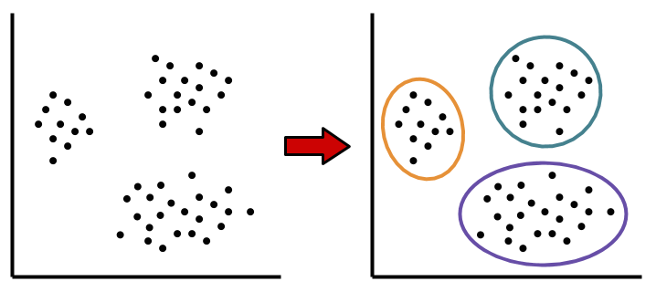
Clustering

Slide 36
K-Means Clustering
To begin, we first select a number of classes/groups to use and randomly initialize their respective center points. To figure out the number of classes to use, it’s good to take a quick look at the data and try to identify any distinct groupings.
Each data point is classified by computing the distance between that point and each group center, and then classifying the point to be in the group whose center is closest to it.
Based on these classified points, we recompute the group center by taking the mean of all the vectors in the group.
Repeat these steps for a set number of iterations or until the group centers don’t change much between iterations.

Slide 37
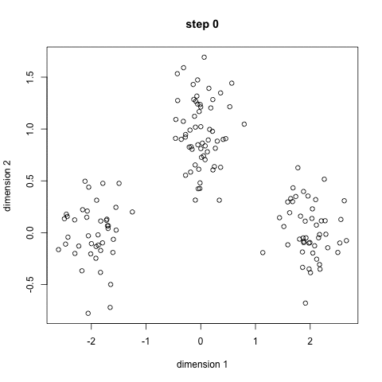

Slide 38
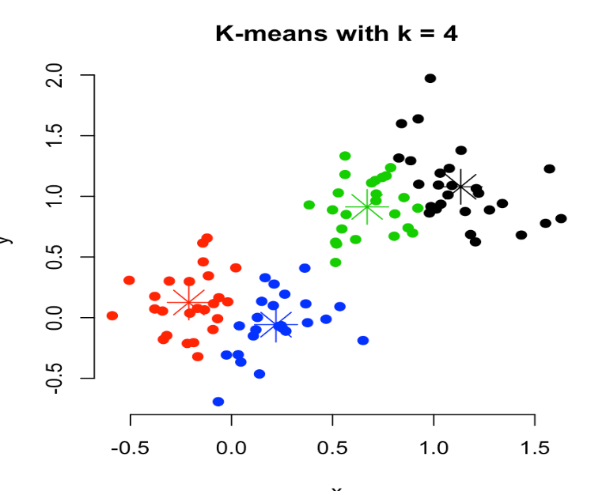
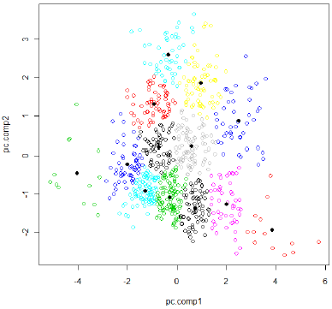
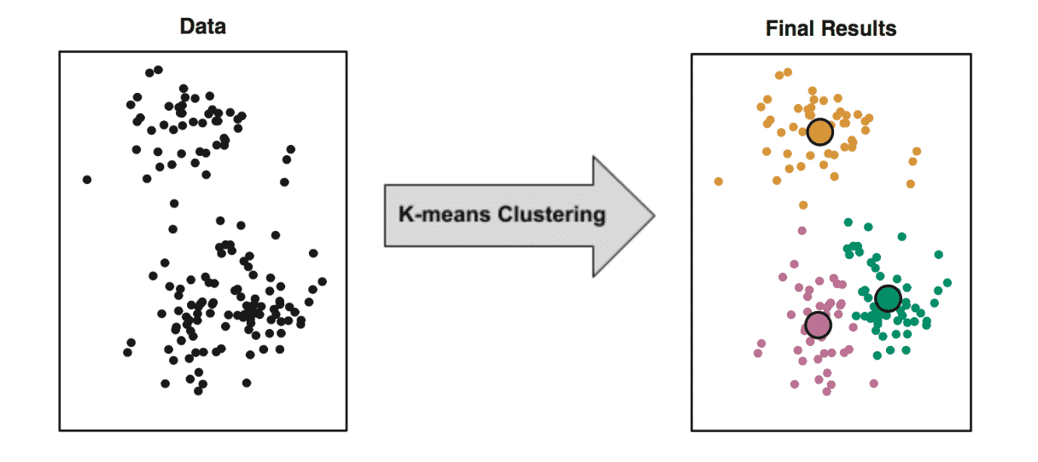
K-Means Clustering

Slide 39
Dimension Reduction Techniques
As data generation and collection keeps increasing, visualizing it and drawing inferences becomes more and more challenging.
The process of reducing the number of random variables under consideration by obtaining a set of principal variables.
Approaches can be divided into feature selection and feature extraction.

Slide 40
Why Dimension Reduction is Required
Space required to store the data is reduced as the number of dimensions comes down
Less dimensions lead to less computation/training time
Some algorithms do not perform well when we have a large dimensions. So reducing these dimensions needs to happen for the algorithm to be useful
It takes care of multicollinearity by removing redundant features. For example, you have two variables – ‘time spent on treadmill in minutes’ and ‘calories burnt’. These variables are highly correlated as the more time you spend running on a treadmill, the more calories you will burn. Hence, there is no point in storing both as just one of them does what you require
It helps in visualizing data.
It is very difficult to visualize data in higher dimensions so reducing our space to 2D or 3D may allow us to plot and observe patterns more clearly

Slide 41
Few Dimension Reduction Techniques
Missing Value Ratio
Low Variance Filter
High Correlation Filter
Random Forest
Backward Feature Elimination
Forward Feature Selection
Factor Analysis
Principal Component Analysis

Slide 42
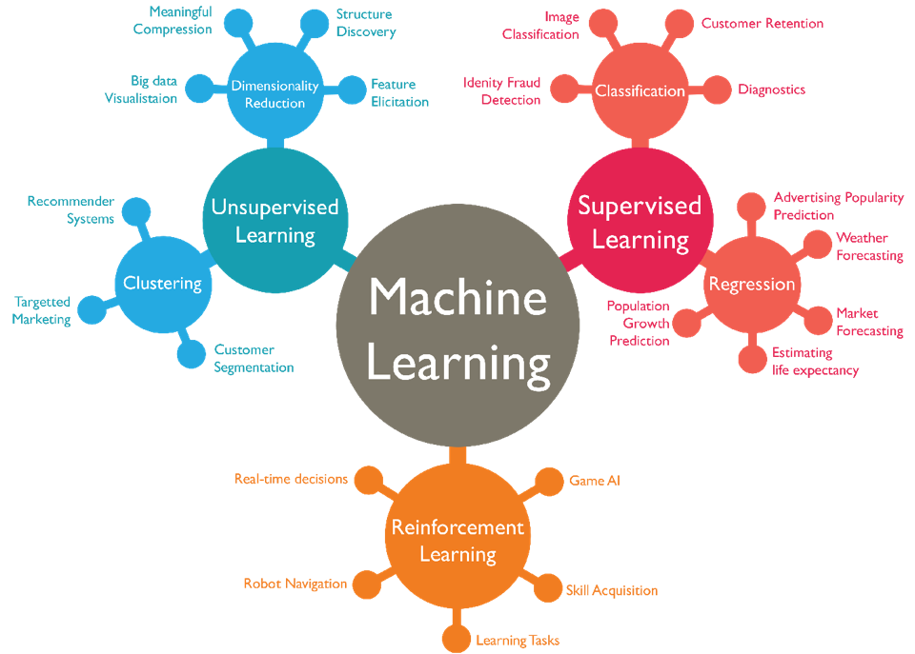

Slide 43
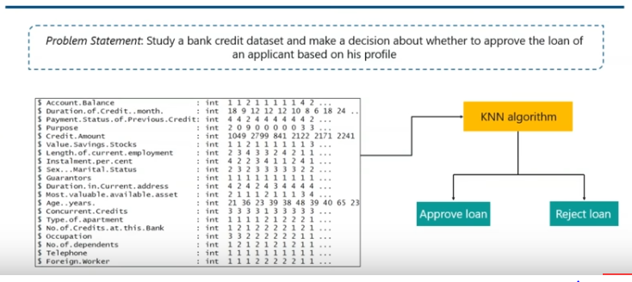
USE CASE 1

Slide 44
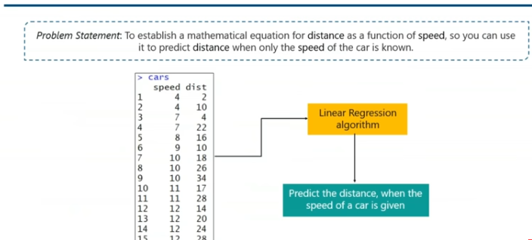
USE CASE 2

Slide 45
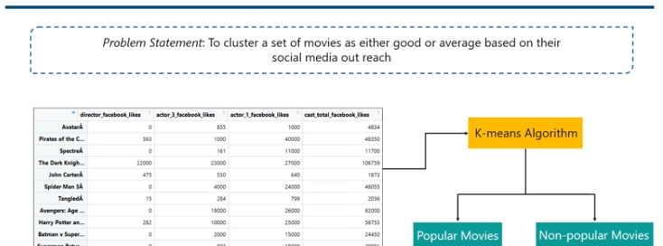
USE CASE 3

Slide 46
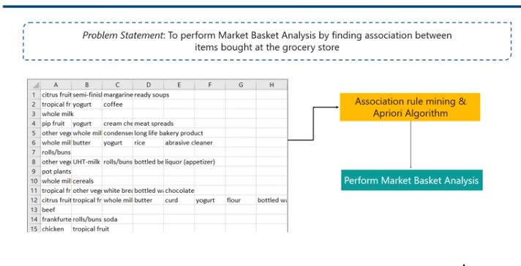
USE CASE 4

Slide 47
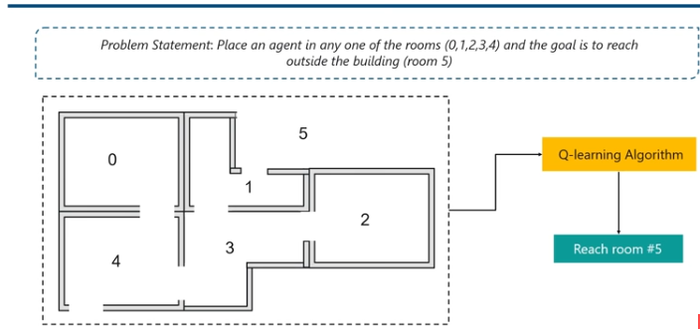
USE CASE 5

Slide 48
Supervised / Unsupervised/Reinforcement LEARNING
Predict the class of a new data by training the machine with a labeled dataset
Predicting the price of a house given a labeled dataset
Product recommendation
Predict a patient is diabetic or not given labeled dataset
Predict the arrival delay time of flights given labeled dataset
Market basket analysis
Self driving Car

Slide 49
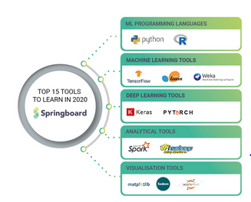

Slide 50
Disclaimer
Contents in the slides are amalgamated from web from various sites

Slide 51
THANK YOU

